Slide 1
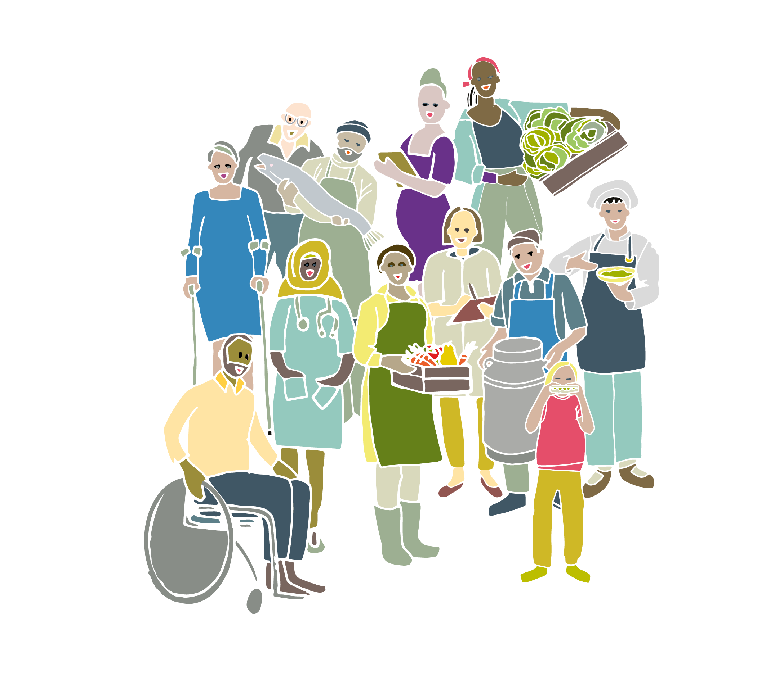

Slide 2
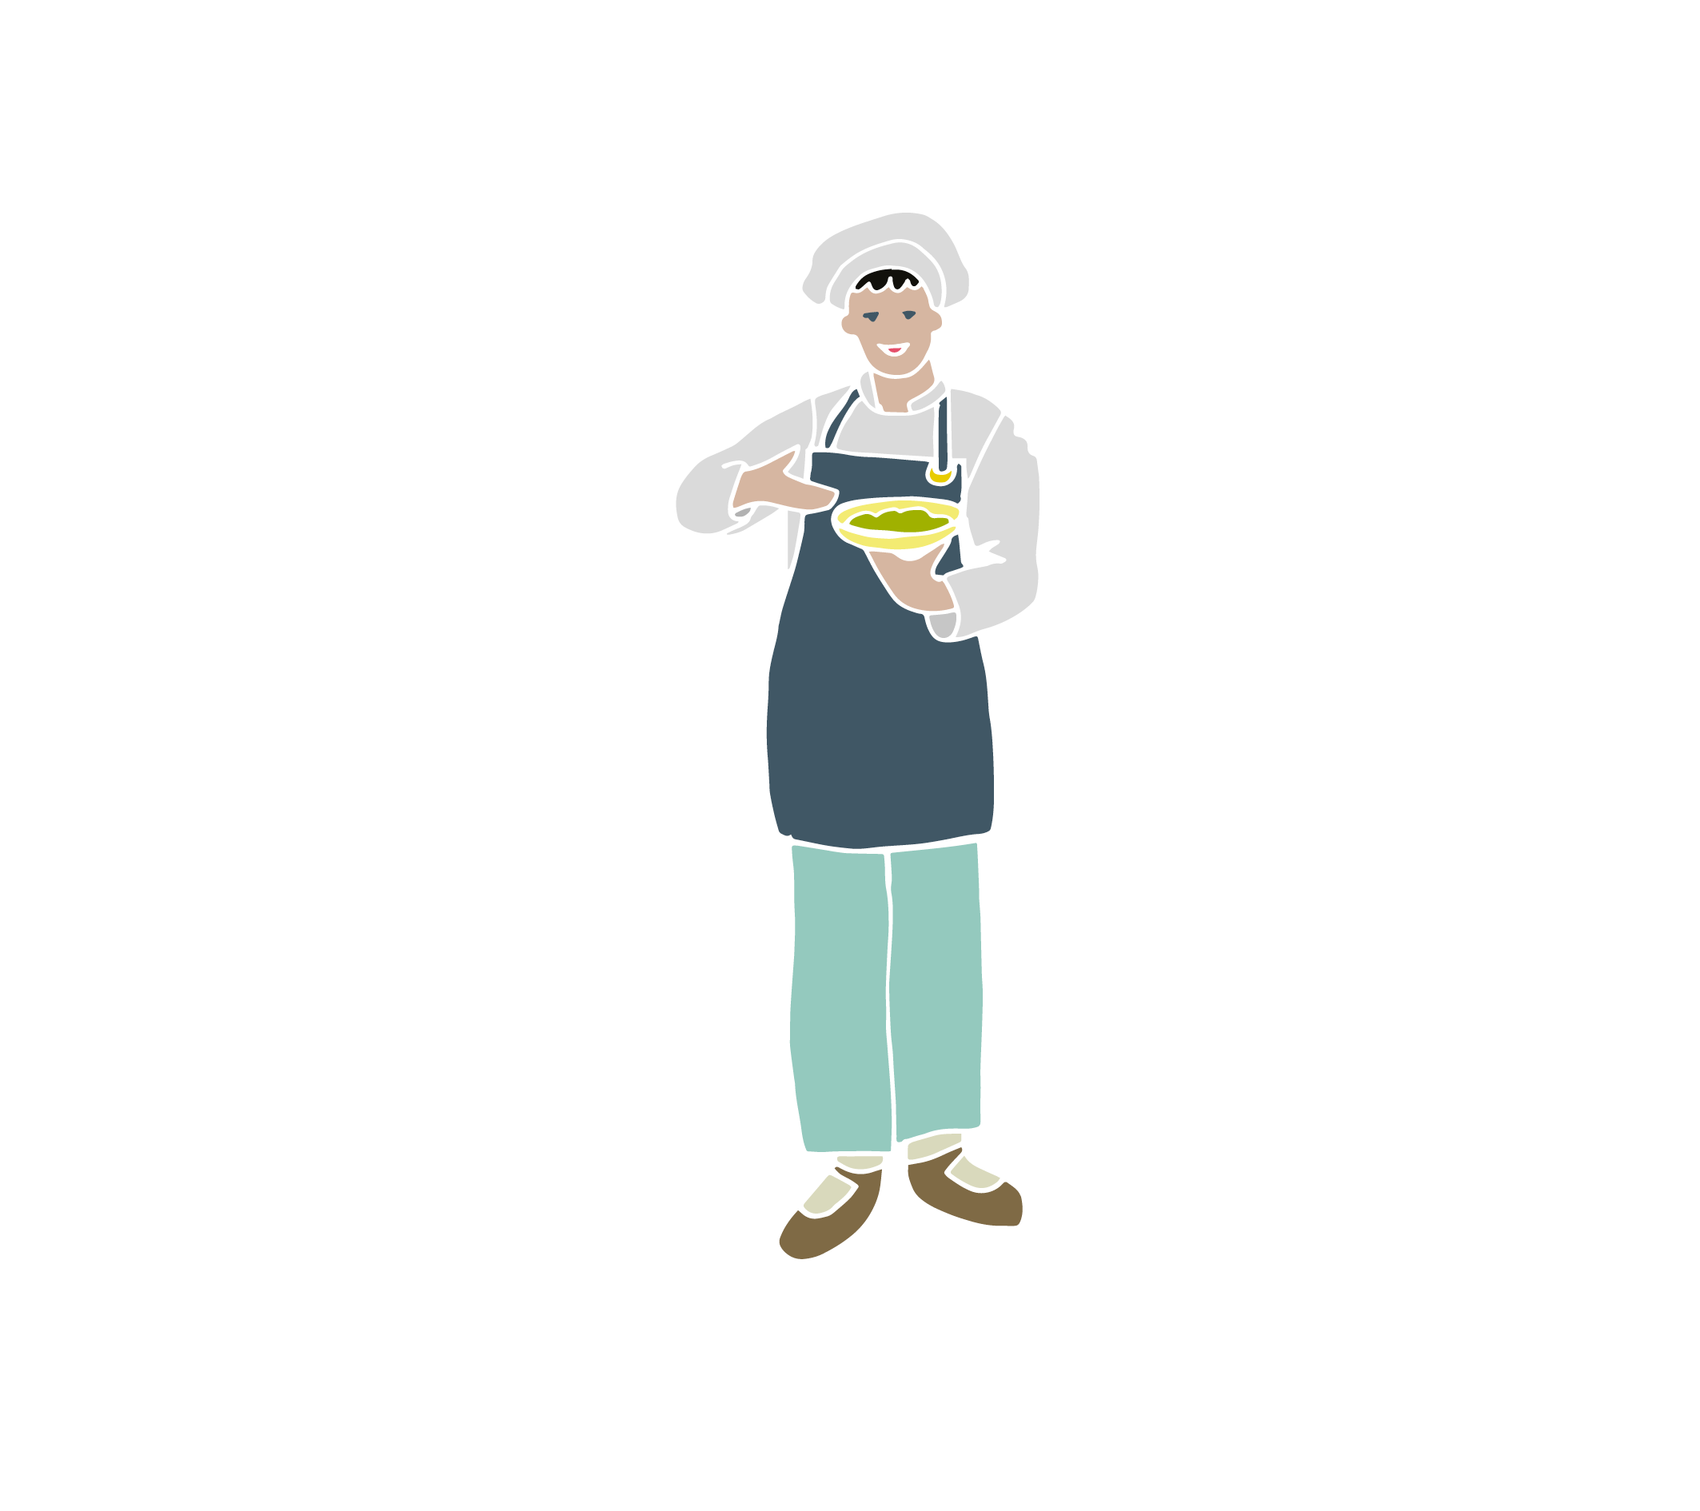
Good Food Nation
Today / this week we’ll learn about:
food in Scotland
what rights have to do with food
criteria needed for Scotland to become
a Good Food Nation
Notes:
Brain stretcher: Can you think of ten foods you eat that we make from farms or from the sea in Scotland?

Slide 3
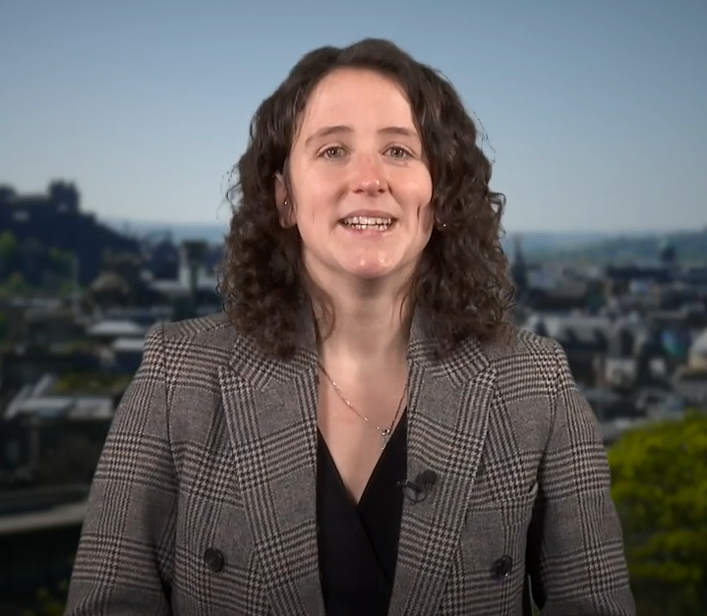
Mairi Gougeon, Cabinet Secretary for Rural Affairs, Land Reform and Islands
Video link
Notes:
https://spaces.hightail.com/space/JJ2jieeFDP/files/fi-6c858b58-3d8b-4d9b-8a25-c788727a3b5c/fv-392e0232-0678-4837-abf1-e1bf81638b04/MG%20-%20Consultation%20on%20Good%20Food%20Nation%20Plan%20for%20young%20people%20CLEAN%20SUBS%20MP4%20-%20060224.mp4

Slide 4
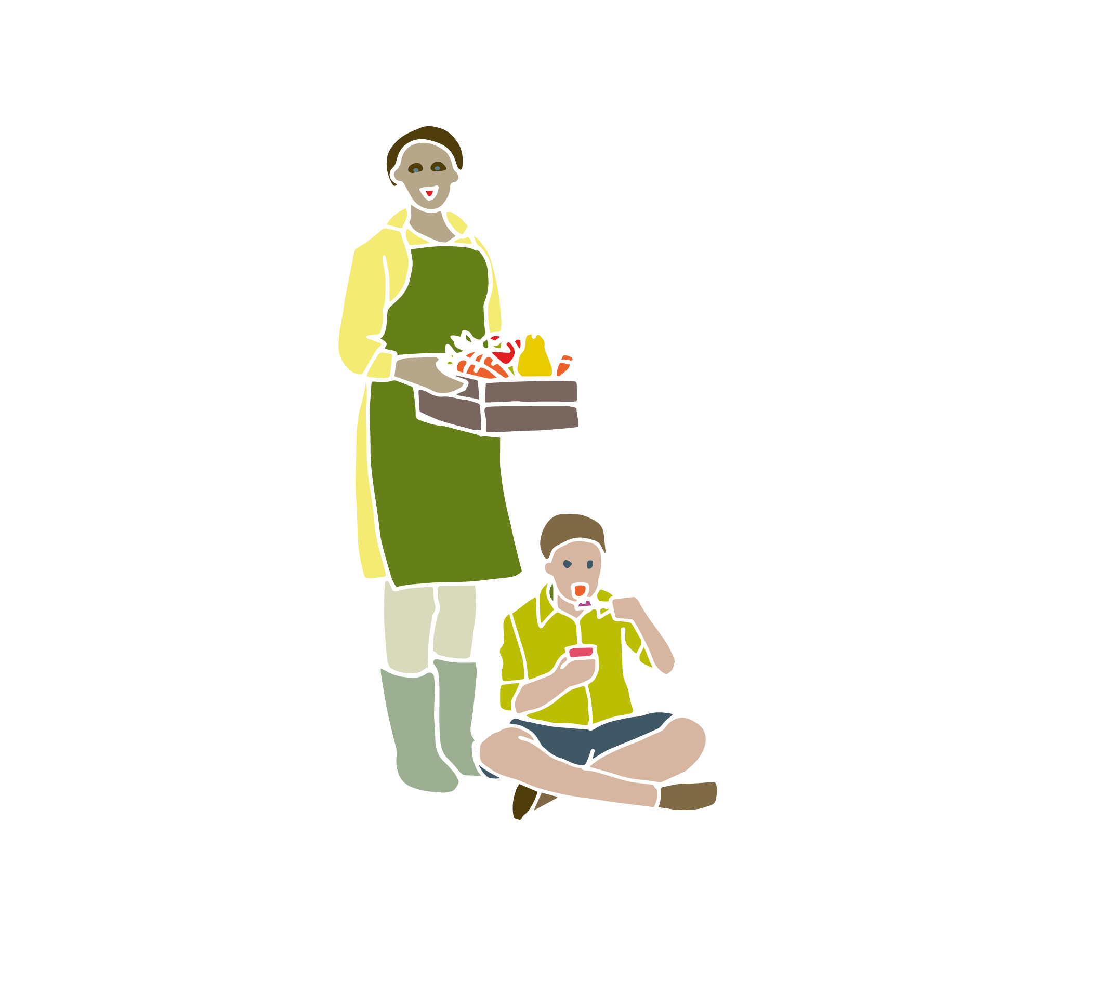
Good Food Nation
…where everyone can take pleasure and pride in the food they produce, buy, cook, serve, and eat each day.
Notes:
Government wants Scotland to become a Good Food Nation, where everyone can take pride and pleasure in the food they produce, buy, cook, serve, and eat each day. Pleasure: what gives you most pleasure when it comes to food?
Prompt for: favourite foods or meals; eating alone or with others - if so with whom; do you enjoy preparing meals or growing food
[4min]

Slide 5
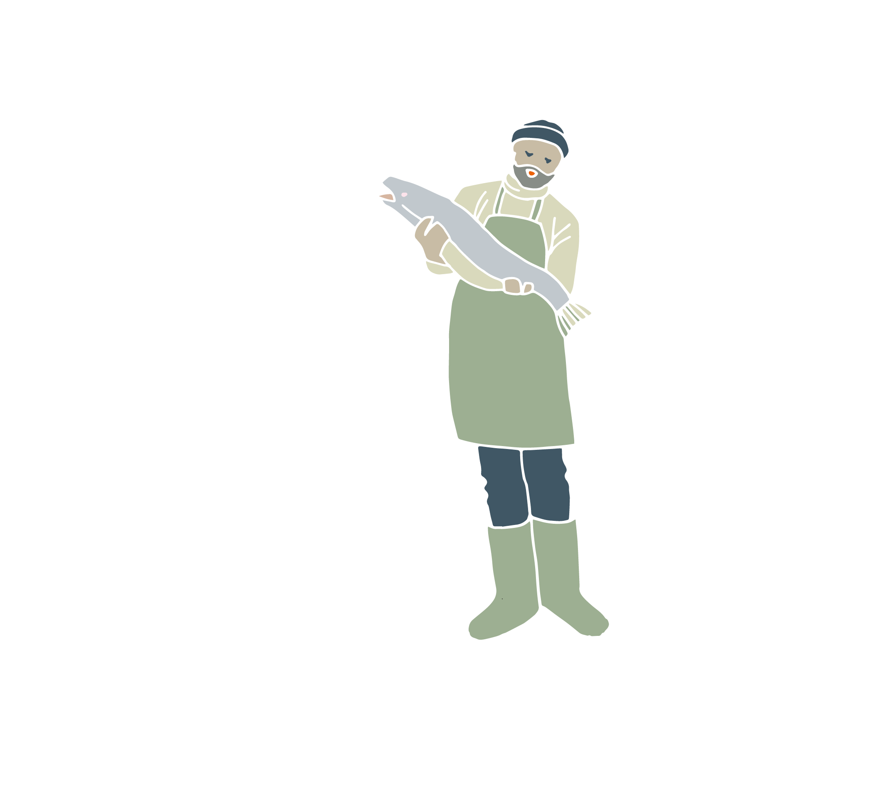
Good Food Nation
…where everyone can take pleasure and pride in the food they produce, buy, cook, serve, and eat each day.
Notes:
Pride: What can we be proud of in Scotland when it comes to food?
[4min]

Slide 6
Good Food Nation
…where everyone can take pride and pleasure in the food they produce, buy, cook, serve, and eat each day.
Notes:
OPTIONAL:
Who is involved in producing, buying, cooking, serving and eating food in Scotland?
Prompt: think from pre-production to waste (people who make tools for farmers; food growers; people who process and package the food; people in shops and takeaways; chefs; parents who make snacks for their children; people who collect and compost food waste)
[5min]
Food system game: There are a lot of people involved in our food system. How do they work together?
Arrange students in a circle. Ask them to pick two other students they are equidistant to, but not tell anyone who they chose. They have to keep the distance to the two students they've chosen. Now, ask one or two of the students to move and watch what happens. What did we notice? (when one person moves, everyone else has to move) What does this tell us about any changes we want to make to the food system in Scotland? (for instance, what if we want to eat more vegetables?)
[10min]

Slide 7

Rights and food
Why are we engaged in this consultation?
Article 12
When adults are making decisions that affect children, they should ask them what they think.
Adults should take account of children’s views when making the decision.
Notes:
[1min]

Slide 8
Rights and food
What rights do we have that entitle us to food?
Notes:
UNCRC What rights do we have that entitle us to food?
[4min]

Slide 9
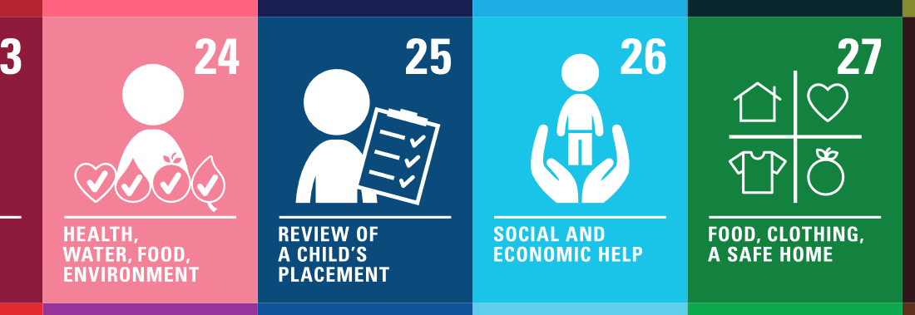

Rights and food
What rights do we have that entitle us to food?
Notes:
UNCRC What rights do we have that entitle us to food?
[4min]
#24 Health, water, food environment
#27 Food, clothing, a safe home
#26 Social and economic help
#4 Making rights real Picture Good Food Nation Paint a picture of you in a Good Food Nation.
OPTIONAL:
Paint a picture of you in a Good Food Nation.
Reminder: Good Food Nation is where everyone can take pleasure and pride in the food they produce, buy, cook, serve, and eat each day.
[10min]

Slide 10
Good Food Nation outcomes
Inclusive
Sustainable
Healthy
Wealth-building
Enjoyable
Global
Notes:
The government has come up with six outcomes to say ‘if we were a Good Food Nation, this is what things would be like’.

Slide 11
Good Food Nation outcomes
Inclusive
Sustainable
Healthy
Wealth-building
Enjoyable
Global
I S H W E G
Notes:
We’re calling these ISHWEG – inclusive, sustainable, healthy, wealth-building, enjoyable and global. Take turns in your groups for someone to read out each of the outcomes in the next slides.

Slide 12
Good Food Nation outcomes
Inclusive
Everyone in Scotland eats well. They can easily get safe, healthy, affordable, environmentally friendly food that suits their age and culture.

Slide 13
Good Food Nation outcomes
Sustainable
Scotland’s food system is good for the natural environment, the climate, wildlife, and animal welfare.

Slide 14
Good Food Nation outcomes
Healthy
Scotland’s food system helps everyone to have good physical and mental health.

Slide 15
Good Food Nation outcomes
Wealth-building
Scotland is known around the world for high-quality food. Our food and drink industry is successful and forward-thinking. It is an important part of the national and local economy. It supports and creates good jobs.

Slide 16
Good Food Nation outcomes
Enjoyable
Scotland has a good food culture. Scottish people are interested in and educated about good and sustainable food.

Slide 17
Good Food Nation outcomes
Global
Decisions we make in Scotland are good for food systems here and around the world. We share and learn from what other countries are doing.

Slide 18
Inclusive
Sustainable
Healthy
Wealth-building
Enjoyable
Global
Notes:
Look at your Good Food Nation pictures - can you highlight where you see these outcomes reflected in your posters? [use highlighters or different coloured stickers to match to different outcomes]
[7min]

Slide 19
Inclusive
Sustainable
Healthy
Everyone in Scotland eats well. They can easily get safe, healthy, affordable, environmentally friendly food that suits their age and culture.
Scotland’s food system is good for the natural environment, the climate, wildlife, and animal welfare.
Scotland’s food system helps everyone to have good physical and mental health.
Wealth-building
Enjoyable
Global
Scotland is known around the world for high-quality food. Our food and drink industry is successful and forward-thinking. It is an important part of the national and local economy. It supports and creates good jobs.
Scotland has a good food culture. Scottish people are interested in and educated about good and sustainable food.
Decisions we make in Scotland are good for food systems here and around the world. We share and learn from what other countries are doing.
Notes:
OPTIONAL SLIDE
Look at your Good Food Nation pictures - can you highlight where you see these outcomes reflected in your posters? [use highlighters or different coloured stickers to match to different outcomes]
[7min]

Slide 20

What do you think?
What are your views on Scotland becoming a Good Food Nation?
https://forms.office.com/Pages/ResponsePage.aspx?id=R3T3DoMQ7E24nyfHZQdoQDNP5hkXMg5Ou7jwyQtENgRUOE5PSVJMM0hKQTdRT041TjhRT0xCWlRJNi4u
Notes:
Today / this week we've been talking about the Good Food Nation and how it relates to rights You've heard Cabinet Secretary say she was looking for your views on Scotland becoming the Good Food Nation. The Government prepared an online form for us to send them our views.
[fill in the form all together: 10-15min]
https://forms.office.com/Pages/ResponsePage.aspx?id=R3T3DoMQ7E24nyfHZQdoQDNP5hkXMg5Ou7jwyQtENgRUOE5PSVJMM0hKQTdRT041TjhRT0xCWlRJNi4u

