Slide 1
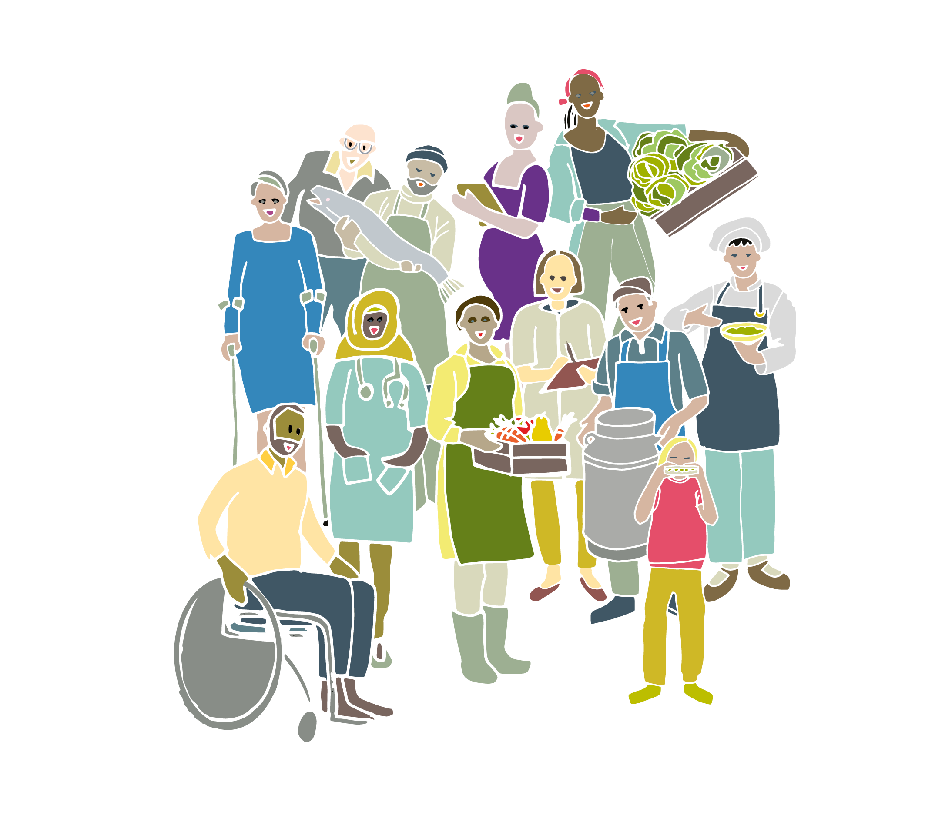
Notes:
The Government has just published the first Good Food Nation Plan for Scotland and they want to hear young people's views on their proposals.

Slide 2

Rights and food
Why are we engaged in this consultation?
Article 12
When adults are making decisions that affect children and young people, they should ask them what they think, and take account of those views when making the decision.

Slide 3
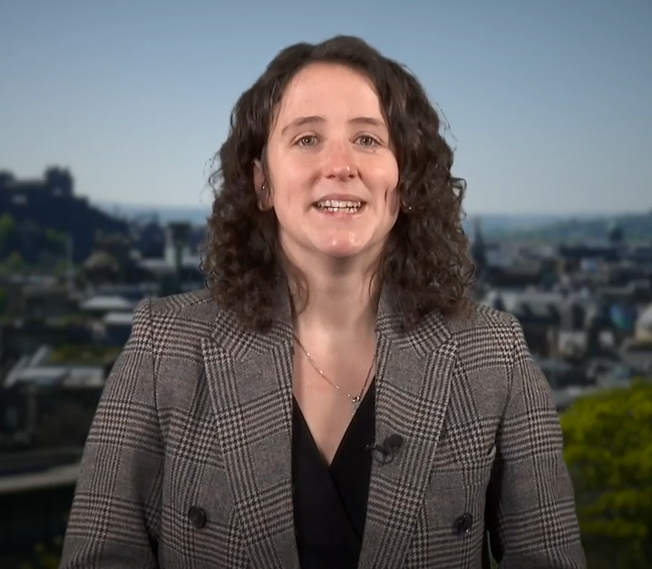
Mairi Gougeon, Cabinet Secretary for Rural Affairs, Land Reform and Islands
Video link
Notes:
https://spaces.hightail.com/space/JJ2jieeFDP/files/fi-6c858b58-3d8b-4d9b-8a25-c788727a3b5c/fv-392e0232-0678-4837-abf1-e1bf81638b04/MG - Consultation on Good Food Nation Plan for young people CLEAN SUBS MP4 - 060224.mp4
[2min]

Slide 4
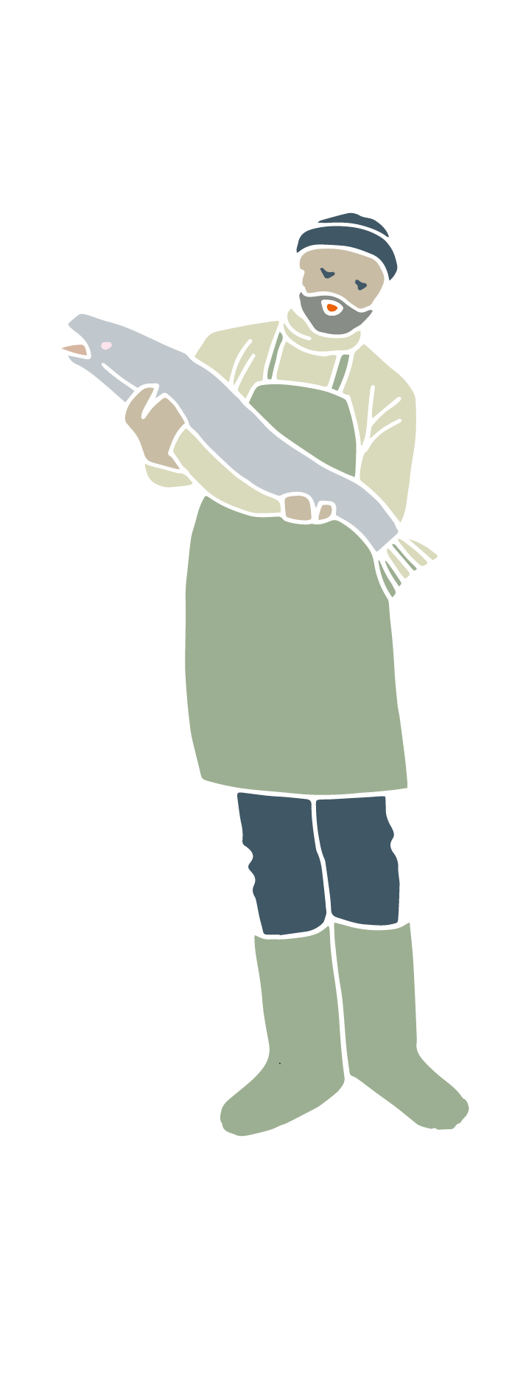

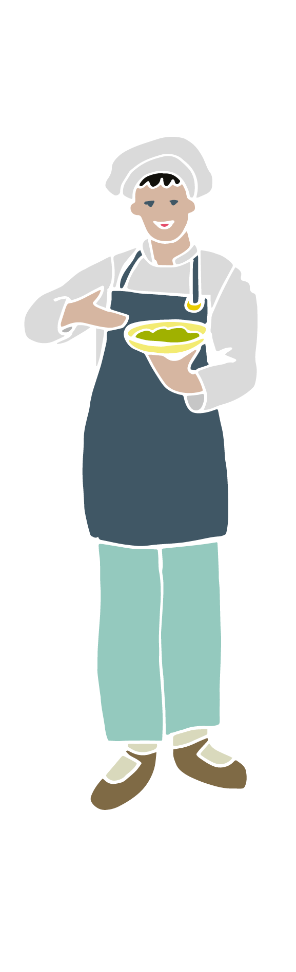
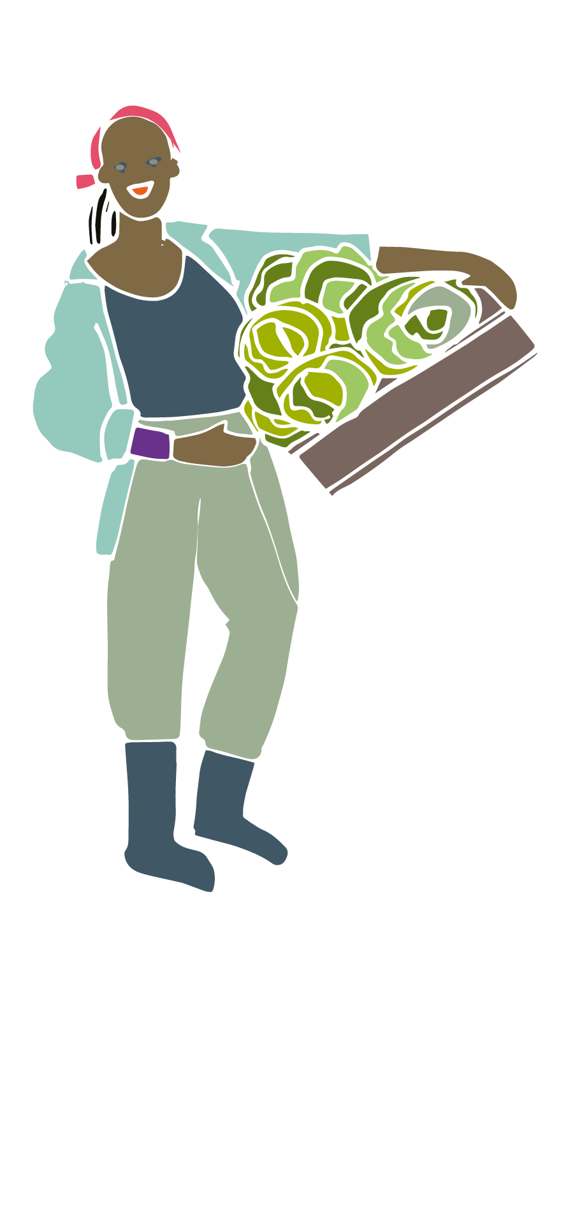
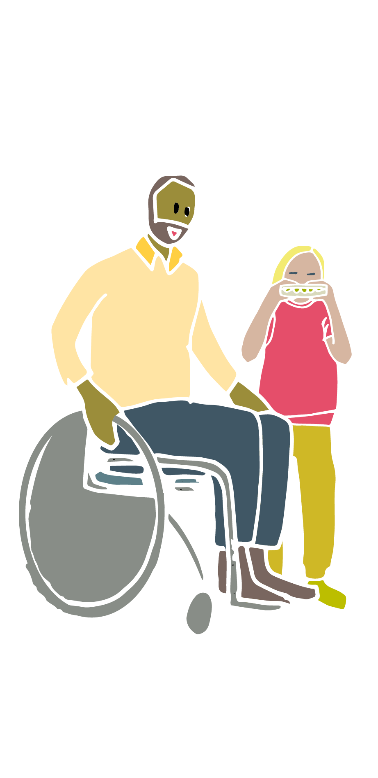
Good Food Nation
…where everyone can take pride and pleasure in the food they produce, buy, cook, serve, and eat each day.
Notes:
Government wants Scotland to become a Good Food Nation, where everyone can take pride and pleasure in the food they produce, buy, cook, serve, and eat each day.
What brings us pride and pleasure when it comes to food in Scotland? What are some of the problems / where do we fall short?
Point to the examples students give to point out connections between them and how many different people / jobs are related to food. Food is a complex topic - which is why it can be helpful to think about food as a system.
[12-15min]
OPTIONAL:
Food systems game Let's play a game to show how a system works in practice. Arrange students in a circle. Ask them to pick two other students they are equidistant to, but not tell anyone who they chose. They have to keep the distance to the two students they've chosen. Now, ask one or two of the students to move and watch what happens. What did we notice? (when one person moves, everyone else has to move) What does this tell us about any changes we want to make to the food system in Scotland? (for instance, what if we want to eat more vegetables?)
[10min]

Slide 5

The food system
Video link
Notes:
https://youtu.be/4Gdyv1rd8MU

Slide 6
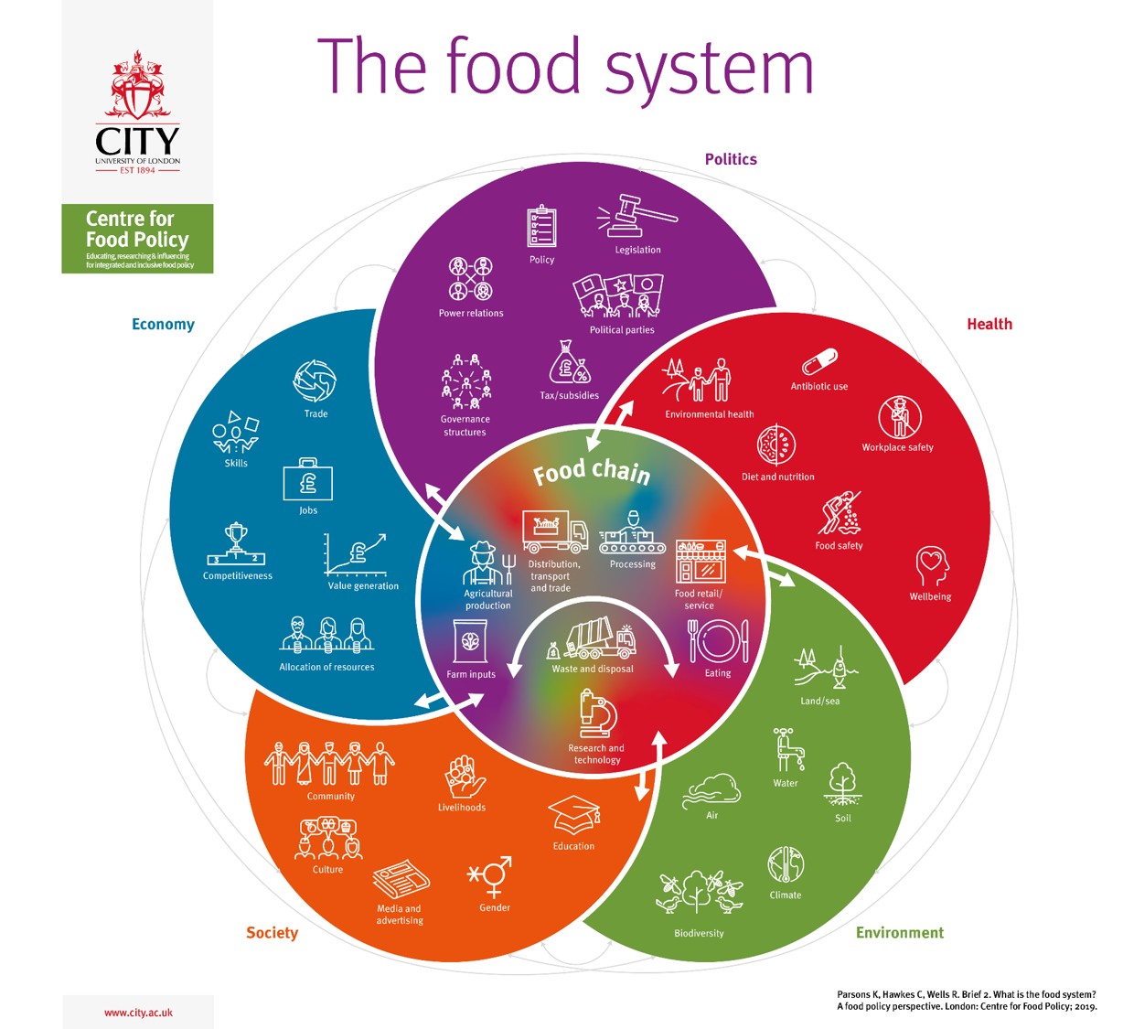
Notes:
Does the map make you think differently about the discussion earlier (about pride and problems)? Do you want to add anything to what you said earlier?

Slide 7
Good Food Nation outcomes
Inclusive
Sustainable
Healthy
Wealth-building
Enjoyable
Global
Notes:
The government has come up with six outcomes for Scotland to achieve to become a Good Food Nation.

Slide 8
Good Food Nation outcomes
Inclusive
Sustainable
Healthy
Wealth-building
Enjoyable
Global
I S H W E G
Notes:
We’re using the acronym ISHWEG to help us remember them: inclusive, sustainable, healthy, wealth-building, enjoyable and global.

Slide 9
Good Food Nation outcomes
Inclusive
Everyone in Scotland eats well. They can easily get safe, healthy, affordable, environmentally friendly food that suits their age and culture.

Slide 10
Good Food Nation outcomes
Sustainable
Scotland’s food system is good for the natural environment, the climate, wildlife, and animal welfare.

Slide 11
Good Food Nation outcomes
Healthy
Scotland’s food system helps everyone to have good physical and mental health.

Slide 12
Good Food Nation outcomes
Wealth-building
Scotland is known around the world for high-quality food. Our food and drink industry is successful and forward-thinking. It is an important part of the national and local economy. It supports and creates good jobs.

Slide 13
Good Food Nation outcomes
Enjoyable
Scotland has a good food culture. Scottish people are interested in and educated about good and sustainable food.

Slide 14
Good Food Nation outcomes
Global
Decisions we make in Scotland are good for food systems here and around the world. We share and learn from what other countries are doing.

Slide 15
Inclusive
Sustainable
Healthy
Wealth-building
Enjoyable
Global
Notes:
Do these outcomes speak to the Good Food Nation as you imagine it? Is anything missing?
[5min]

Slide 16
Inclusive
Sustainable
Healthy
Everyone in Scotland eats well. They can easily get safe, healthy, affordable, environmentally friendly food that suits their age and culture.
Scotland’s food system is good for the natural environment, the climate, wildlife, and animal welfare.
Scotland’s food system helps everyone to have good physical and mental health.
Wealth-building
Enjoyable
Global
Scotland is known around the world for high-quality food. Our food and drink industry is successful and forward-thinking. It is an important part of the national and local economy. It supports and creates good jobs.
Scotland has a good food culture. Scottish people are interested in and educated about good and sustainable food.
Decisions we make in Scotland are good for food systems here and around the world. We share and learn from what other countries are doing.
Notes:
OPTIONAL SLIDE:
Do these outcomes speak to the Good Food Nation as you imagine it? Is anything missing?
[5min]

Slide 17

What do you think?
What are your views on Scotland becoming a Good Food Nation?
https://forms.office.com/Pages/ResponsePage.aspx?id=R3T3DoMQ7E24nyfHZQdoQDNP5hkXMg5Ou7jwyQtENgRUOE5PSVJMM0hKQTdRT041TjhRT0xCWlRJNi4u
(teacher-led form for students below 13 years old)
Notes:
Teacher-led form (students below 13 years old)
https://forms.office.com/Pages/ResponsePage.aspx?id=R3T3DoMQ7E24nyfHZQdoQDNP5hkXMg5Ou7jwyQtENgRUOE5PSVJMM0hKQTdRT041TjhRT0xCWlRJNi4u

Slide 18

What do you think?
What are your views on Scotland becoming a Good Food Nation?
https://forms.office.com/Pages/ResponsePage.aspx?id=R3T3DoMQ7E24nyfHZQdoQDNP5hkXMg5Ou7jwyQtENgRUREpXVFVZT08zOEw1TUpWRDNRUFAwRlRJWS4u
(individual responses for students aged 13 years and above)
Notes:
Individual responses (students aged 13 years old and above)
https://forms.office.com/Pages/ResponsePage.aspx?id=R3T3DoMQ7E24nyfHZQdoQDNP5hkXMg5Ou7jwyQtENgRUREpXVFVZT08zOEw1TUpWRDNRUFAwRlRJWS4u

